Slide 1
PATIENT HEART HEALTH DASHBOARD
A POWER BI DATA VISUALIZATION PROJECT
NAME: SURESHKUMAR DATE: 12/06/2025 DADS MARCH: 2025

Slide 2
DATASET OVERVIEW
This dataset contains medical records of 303 patients, used for predicting the likelihood of heart disease based on various clinical features. It is widely used in machine learning and data analysis projects related to healthcare risk prediction.
DESCRIPTION
Each record captures a variety of patient attribuites including demographic information medical test result and symptoms.
The primary goal is to use there features to detemain wheater a person is likely to have heart disease or not.

Slide 3
DATA CLEANING
Before analysis, the dataset was reviewed for quality and consistency.
The following steps were performed to ensure data reliability
Removed duplicate records (if any)
Checked for missing values — none found in key columns
Renamed ambiguous column headers for clarity (e.g., cp → Chest Pain Type)
Converted coded values to readable labels (e.g., sex 0 = Female, 1 = Male)
Ensured proper data types (e.g., numerical fields like age, chol)

Slide 4
DAX FUNCTION
DAX Function
SUM()
AVERAGE()
COUNT()
DISTINCTCOUNT()
IF()
CALCULATE()
ALL()
RANKX()
RELATED()
DATEADD()
ROUND()
Sample Use
Total Cholesterol: SUM(heart[chol])
Avg BP: AVERAGE(heart[trestbps])
Total Patients: COUNT(heart[ssn])
Unique Ages: DISTINCTCOUNT(heart[age])
Target Label: IF(heart[target] = 1, "Heart Disease", "No Disease")
Avg Chol for Diseased: CALCULATE(AVERAGE(heart[chol]), heart[target] = 1)
Ignore filters: CALCULATE(AVERAGE(heart[chol]), ALL(heart))
Cholesterol Rank: RANKX(ALL(heart), heart[chol])
If multiple tables used: pull related data
For trends if time-based data is available
Round averages: ROUND(AVERAGE(heart[chol]), 0)

Slide 5
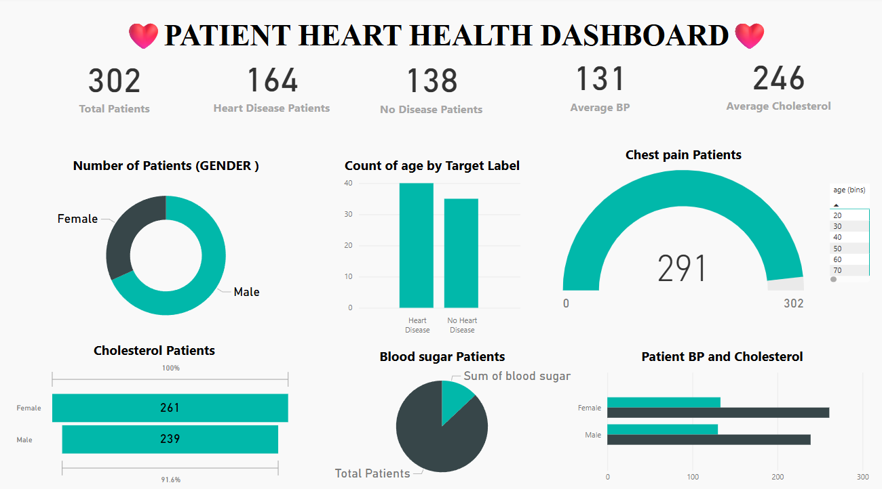
DASHBOARD OVERVIEW

Slide 6
KEY INSIGHTS
Age Distribution
Most patients are between 43-71 years old, showing this dataset focuses on middle-aged to older adults who are more at risk for heart disease.
Gender Split
In dataset has both male and female patients, with males being more represented (helpful for comparing heart disease risk between enders).
Heart Disease Rate
50% of patients in your dataset have heart disease (9 out of 18), which is higher than normal population rates.
Blood Pressure Patterns
Resting blood pressure ranges from 100-160, with most patients having elevated levels (normal is below 120).
Exercise Limitations
Some patients experience chest pain during exercise, indicating potential heart problems.
Age and Risk
Older patients (60+) show more heart disease indicators, confirming age as a risk factor.

Slide 7
CONCLUSION
The analysis of heart disease data revealed key health risk indicators such as high cholesterol, advanced age, and lower maximum heart rate.
Visualizations provided clear insights into how certain clinical factors correlate with heart disease occurrence.
The dashboard effectively highlights high-risk patient groups, supporting better awareness and early detection.
This project demonstrates how data-driven healthcare can assist in preventive decision-making and targeted medical interventions.

Slide 8
THANK YOU

